Slide 1

Smart Attendance System
Dr . Babasaheb Ambedkar Technological University, Lonere
Department Of Information Technology
Presented By-
Harsh Ramkrishna Patil (2130331246052)
Gargi Rajendra Mahajan (2130331246027)
Guided By-
Dr. Vinod J. Kadam

Slide 2
Contents
Introduction
Problems
Literature Survey
Methodology
System Design
Algorithm Used
Libraries Used
Result Analysis
Applications and Benefits
Conclusion

Slide 3
Introduction
The Smart Attendance System is an IoT-based solution designed to automate and digitize the process of student attendance.
By integrating a fingerprint scanner, ESP8266 microcontroller, and a Flask-based backend, the system ensures accurate, secure, and real-time attendance tracking.
It eliminates manual errors and enables efficient attendance management for academic institutions.

Slide 4
Problems
Traditional attendance methods are time-consuming, error-prone, and vulnerable to proxy attendance.
Manual record-keeping creates inefficiencies in data handling and lacks real-time monitoring.
There is a need for an automated, accurate, and tamper-proof system that can streamline the attendance process and maintain reliable records.

Slide 5
Literature Survey
Previous systems have explored RFID-based and facial recognition solutions.
Challenges: RFID is prone to misuse, and facial recognition faces challenges in accuracy and privacy
Biometric-based approaches, particularly fingerprint-based systems, offer higher reliability, unique identity verification, and cost-effective implementation for academic environments.

Slide 6
Methodology
Our system captures a student’s fingerprint using an R307S sensor connected to an ESP8266 NodeMCU.
The ESP matches fingerprints locally and sends attendance records to a Flask server over Wi-Fi.
The backend stores the data in a MySQL database and provides a dashboard for students, teachers, and admin users to interact with real-time attendance reports.

Slide 7

System Design
Hardware Layer: R307S fingerprint sensor, SH1106 OLED, ESP8266, 9V battery (regulated via LM2596 module)
Communication Layer: Wi-Fi (using mobile hotspot) with ESP sending data via HTTP to Flask
Backend Layer: Flask web framework with MySQL database
Frontend Layer: HTML/CSS/JS dashboards for students, teachers, and admin
Power Supply: Portable battery with power switch

Slide 8
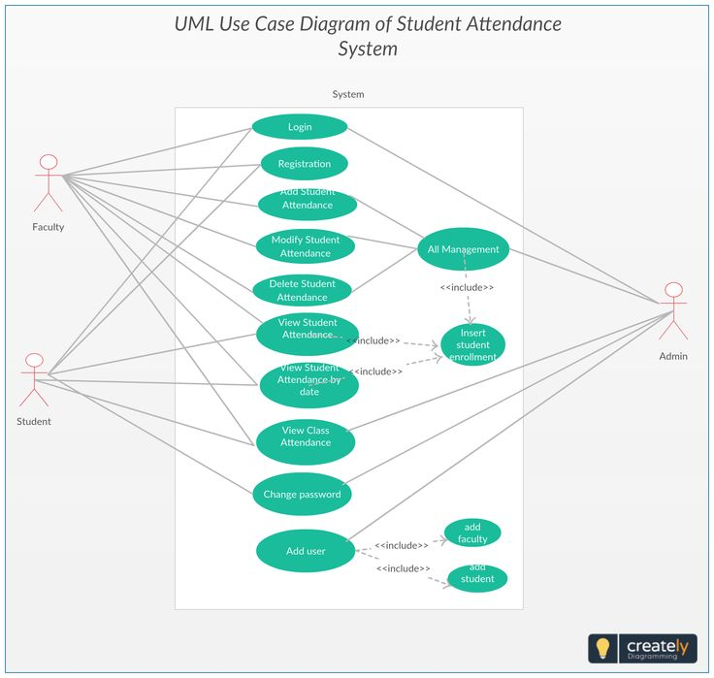
System Design
Use Case Diagram

Slide 9
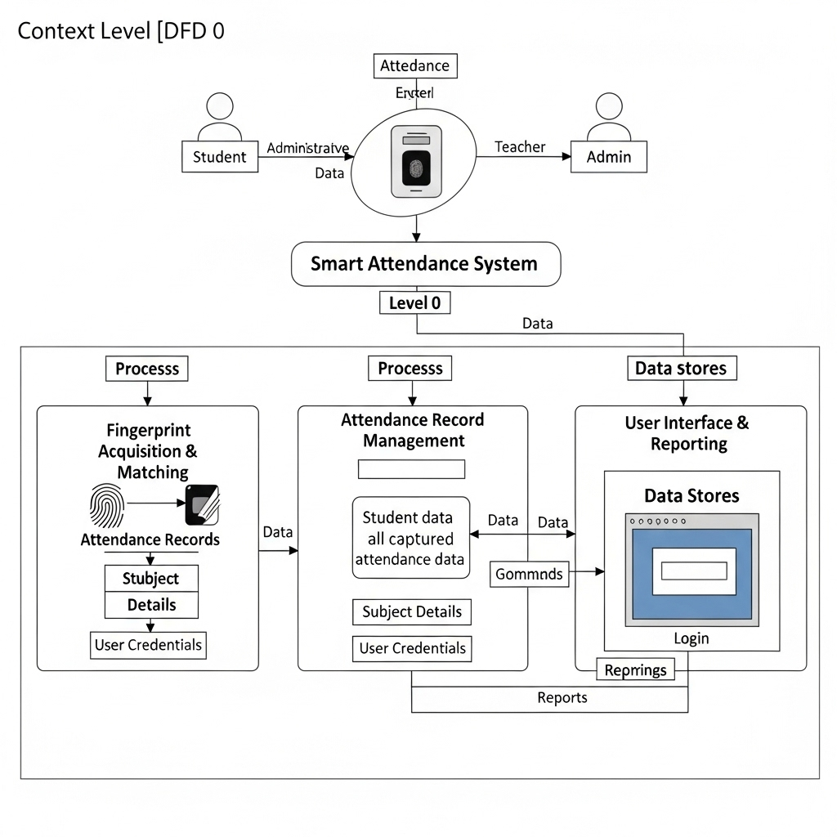
System Design
Data Flow Diagram

Slide 10
Algorithm Used
Fingerprint Enrollment & Matching: Fingerprint templates are stored in the ESP memory and matched locally using the Adafruit_Fingerprint library.
Flask IP Syncing: ESP dynamically receives Flask’s IP using a custom /receive_flask_ip route and responds with pong to identify itself during subnet scanning.
Attendance Validation: On match, the system checks the date and subject, and records attendance only if it hasn’t been marked already.

Slide 11
Libraries Used
ESP Side:
ESP8266WiFi.h
ESPAsyncWebServer.h
Adafruit_Fingerprint.h
SoftwareSerial.h
U8g2lib.h
ArduinoJson.h
ESP8266HTTPClient.h

Slide 12
Libraries Used
Flask Side:
Flask
requests
mysql-connector-python
json

Slide 13
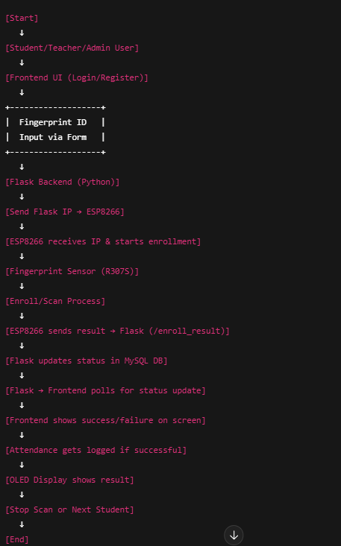
System Flow

Slide 14
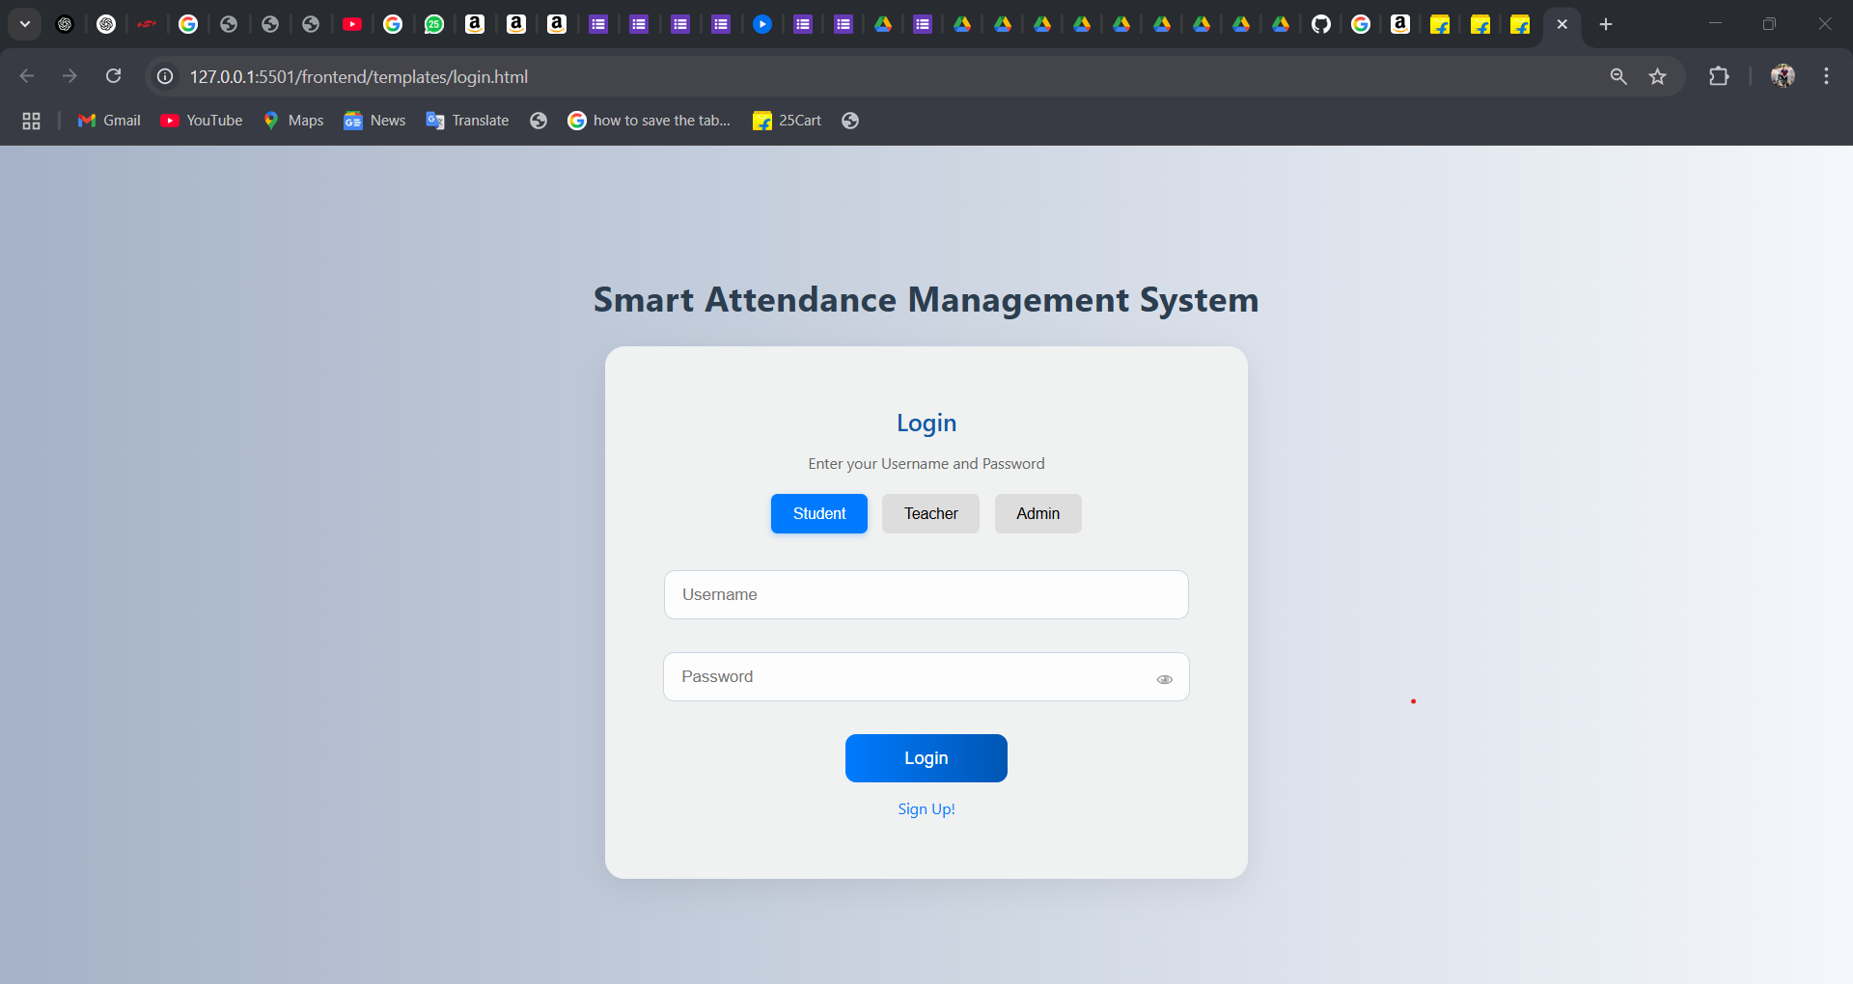
User Interface

Slide 15
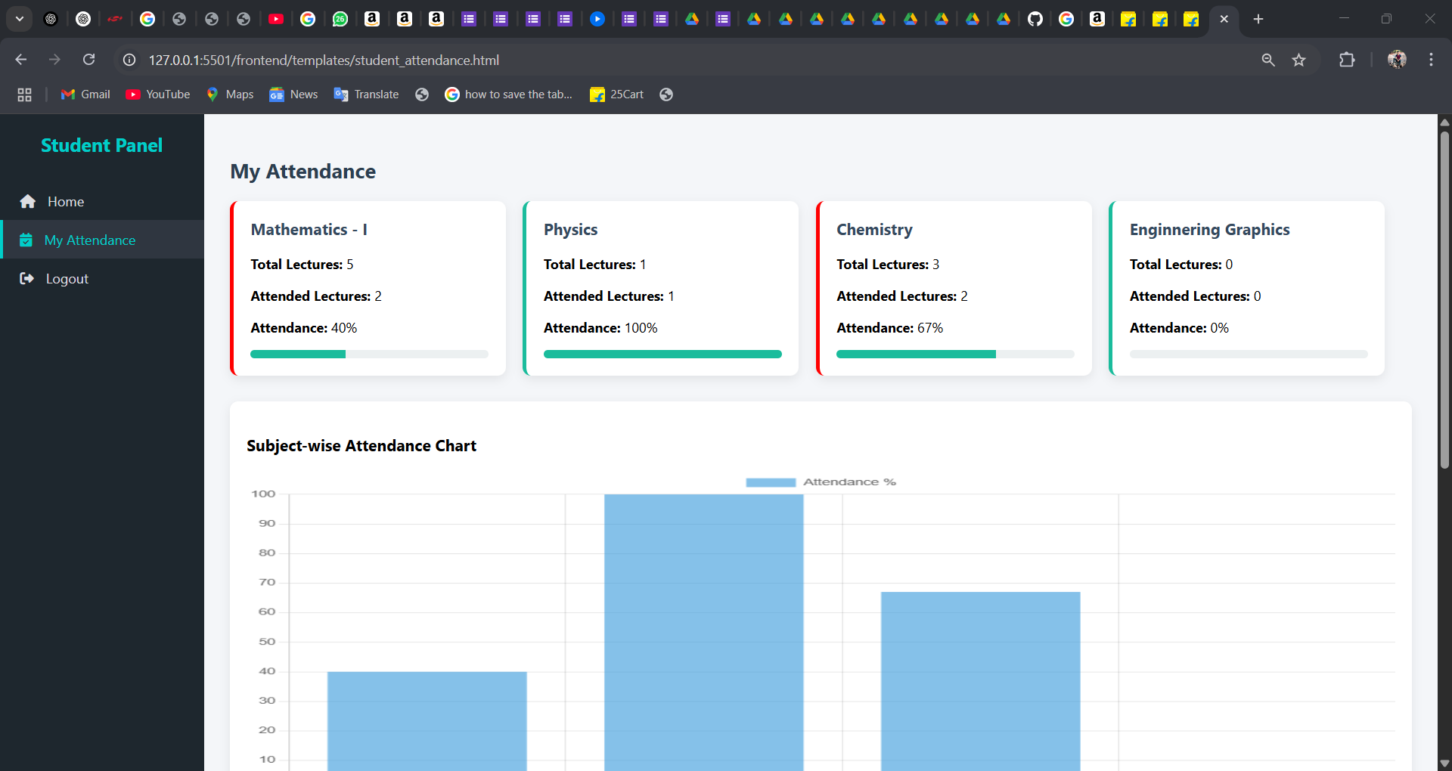
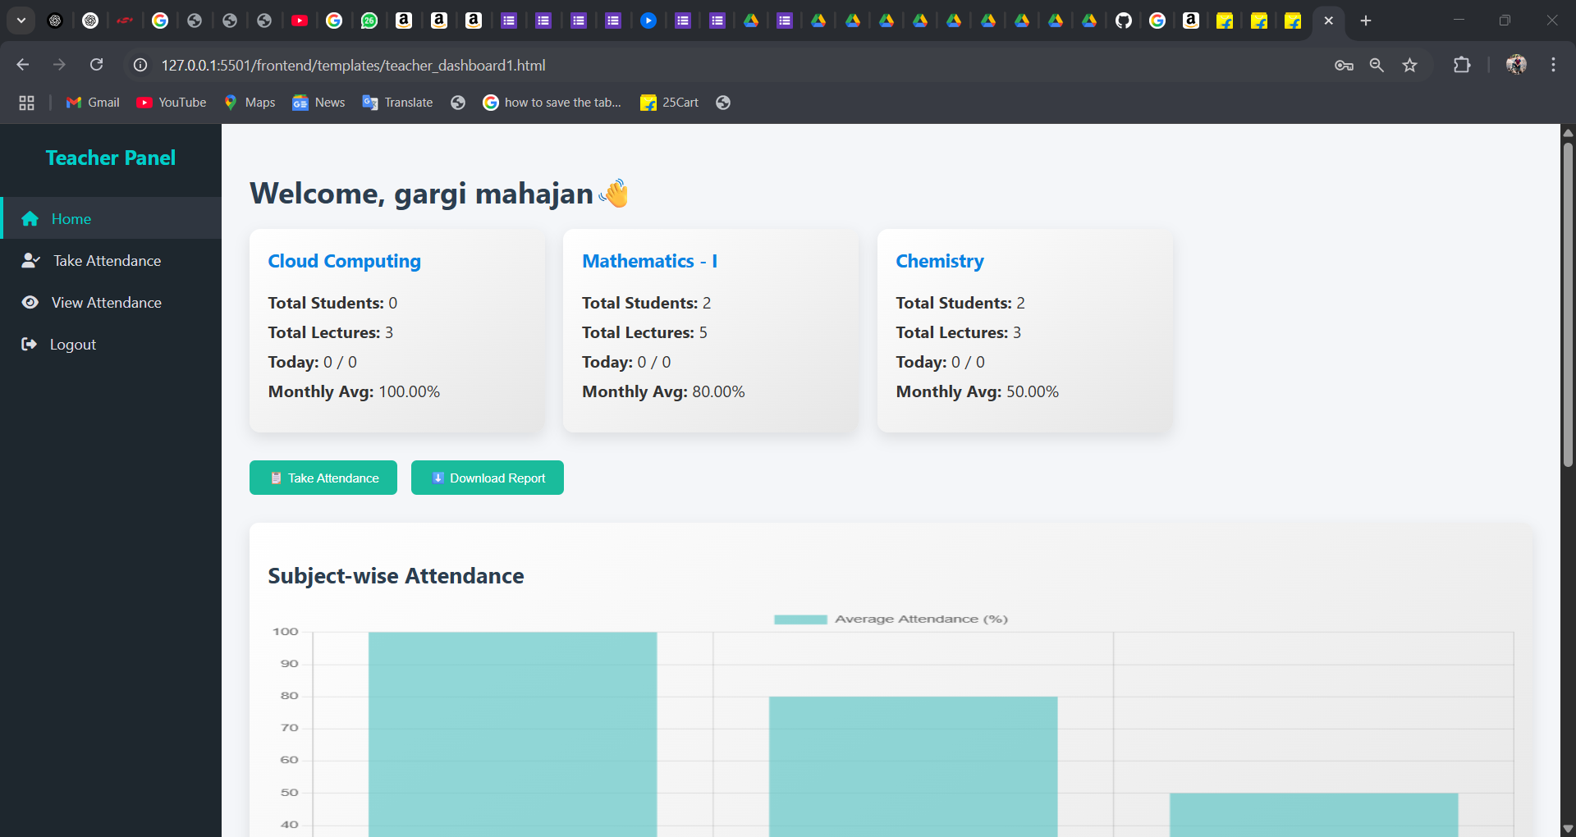
Result Analysis
Student Dashboard
Teacher Dashboard

Slide 16
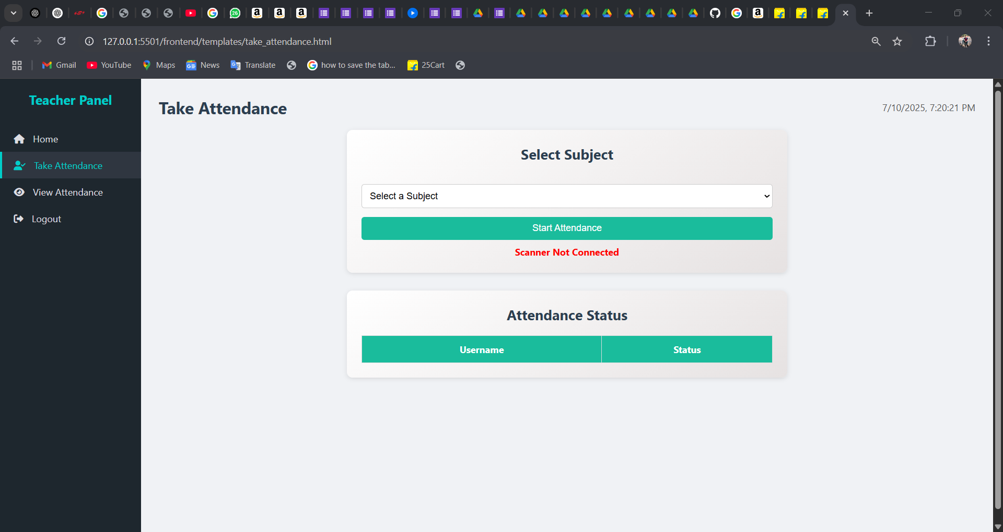
Result Analysis
Attendance Dashboard

Slide 17
Benefits
Eliminates proxy attendance
Real-time data syncing and visibility
Portable and low-cost hardware
Easy integration into existing academic workflows

Slide 18
Applications
Schools, Colleges, Coaching Institutes
Employee Attendance in Offices
Labs and Exam Hall Verification

Slide 19
Conclusion
The Smart Attendance System successfully addresses the shortcomings of traditional attendance methods by providing an automated, accurate, and secure IoT-based solution. Leveraging a fingerprint scanner, ESP8266, and Flask backend, the system delivers real-time attendance tracking with over 98% accuracy, eliminating proxy attendance and manual errors.
Its portable and low-cost hardware makes it a practical and efficient tool for academic institutions and other organizations, significantly streamlining attendance management and ensuring reliable record-keeping. This system presents a robust and scalable alternative for modernizing attendance processes.

Slide 20
Thank You!!!!

